Slide 1
Transforming a business from license selling to service provider
Notes:
Welcome and thank you for coming!
Last year when I visited Iasi and gave a guest lecture at your University I was invited by professor Alboaie to come back this year but only if I would focus more on the business side of Cloud Computing. As she told me, you are all well educated about the technical aspects of Cloud Computing, it would be nice if you would experience a little bit of economical aspects.
So we decided to do a workshop instead of another lecture. You have now the opportunity to enter the world of cloud entrepreneurs, will be fun or not?

Slide 2
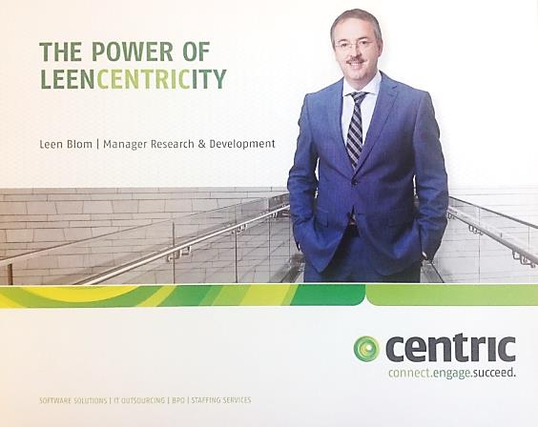
About Me
Leen Blom
Manager Research & Development at Centric
Background in software development, database management, application design, head software development, architect, R&D manager
Consultant, Manager consultancy, R&D manager
Now member of team Enterprise Innovation
Member of Contact Group Universities, guest lecturer at Rotterdam University of applied sciences
Notes:
My name is Leen Blom, I am responsible for Research & Development at Centric Netherlands, an IT company with a subsidiary in Iasi. The Iasi department is responsible for part of our software development activities.
I did a lot of activities in IT from application design, software factory manager, architect and the last 8 years research and development. R&D is performed by our departments, but coordination is required to prevent double research and to get funding from our board, but also from external entities like government and EU. Many projects are subsidized which helps us to do more than we could affort by ourselves.
Last 2 years I am a member of the Enterprise Innovation team, a team that supports the board in decision making, assists departmental directors in long term strategy and my job is to streamline decision making about technical choices to be made. Which is a tough job because software becomes legacy the moment it is first released.

Slide 3
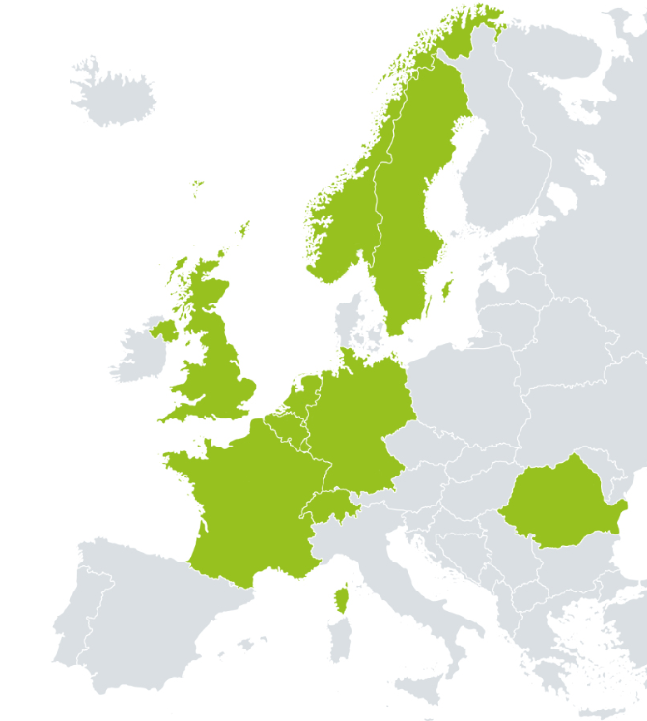
Facts & figures
Founded in 1992 by owner Gerard Sanderink
5.000 people helping you succeed
Progress by solid financial policy
Turnover of 494.4 million euros
Profit (after tax) 15.5 million euros
Fulfilling realistic solutions & services
Software Solutions
IT Outsourcing
Business Process Outsourcing
Staffing Services
International partner, local presence

Slide 4
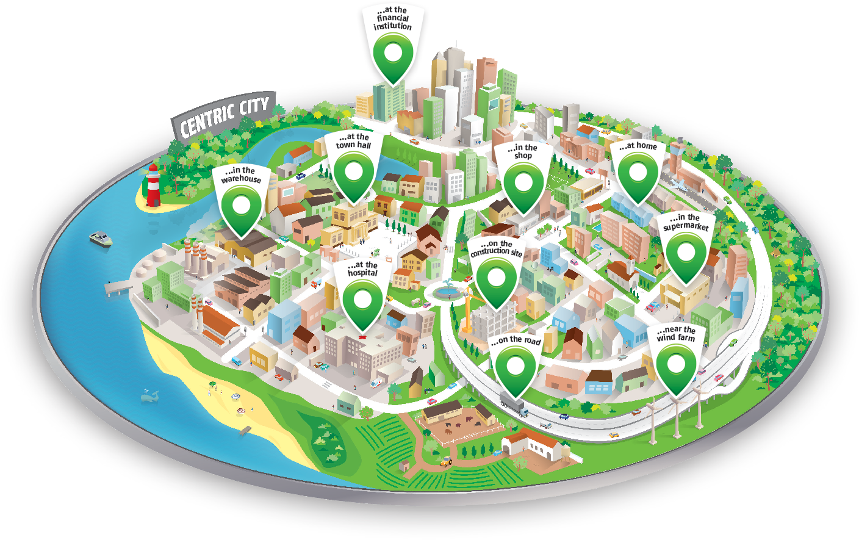

Slide 5
agenda
Software portfolio management
Example 1: Human Resource & Payroll renewal project
Example 2: Tax software transition to SaaS
Assignment Kick-off
“Making money with the cloud”

Slide 6
1st Example renewal project

Slide 7
1st Example: renewal project
One division
About 100 software applications
Men year to rebuild: thousands
Example department
Human Resource & Payroll Solutions (HRPS)

Slide 8

Challenge in 2012
Centric is a company of many acquired organizations
HRPS is a merger of 3 companies
120 employees
For HR and Payrolling each 3 applications + selfservice portal
Interlinked
Markets: profit and non-profit
HR products licensed
Payrolling: software as a service
Organization sub-optimal
6 product management groups
Overall competitiveness declining
But still profitable!
YouPP
PIMS@all
PersMaster
PMvdO
LPS
PayMaster
PASO

Slide 9
Overall plan
One product line for HR and Payrolling
Delivered as Software-as-a-Service (SaaS)
Selfservice for employees (ESS), managers (MSS)
Deliver first MVP in 2016
But how? And what would be the cost and lead time?
Approach
Part 1: Decision scenario for upgrading HR systems
Part 2: Decision on what payrolling system should remain

Slide 10
Estimations notes
Estimations are lean & mean
If something already works, do not change it
When developing to bridge functional differences, rebuild it “as is” and not “fancier”
The team that has to develop the new functionality made the estimation
All estimations are high level effort estimations, not a planning
Does not include project overhead
Does not include the performing of the conversions

Slide 11
Part 1: HR systems

Slide 12
HR systems
Comprises functionality for
Employees, benefits
ESS: Employee Self Service
Hours, leave, pension
Managers
MSS: Manager Self Service
Approvals, promotions
HR Professional
PSS: Professional Support Services
Contracts, payroll

Slide 13
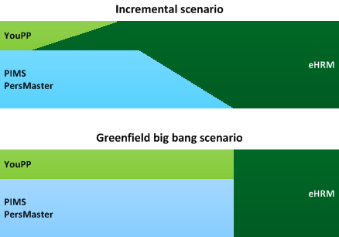
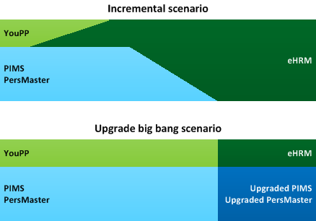
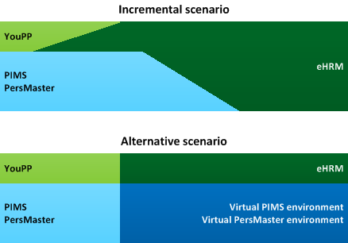
4 HR scenarios
eHRM
Incremental scenario
Current approach, many intermediate deliveries
All levels rebuilt
Greenfield scenario
Completely rebuild the HR software
All levels rebuilt, big bang delivery
Upgrade scenario
Refresh HR software and make it Cloud-based
ESS and MSS rebuilt, PSS upgraded, big bang
Time to market scenario
Encapsulate HR into a Cloud-accessible application
ESS and MSS rebuilt, PSS virtualized
t
2017
?
?

Slide 14
eHRM scenario constraints
Constraints for all scenario’s:
Development & testing for eHRM in Romania
Requirements & functional design for eHRM in the Netherlands
SaaS only, multi tenant, upgradable UI for eHRM
No intermediate delivery of releases
Worst case / best case percentages are based on estimation confidence levels of development team

Slide 15
Greenfield scenario description
eHRM consists of newly developed self service and HR functionality as one new solution
Completely rebuild of software
Result: All levels rebuilt, big bang delivery

Slide 16
Greenfield scenario estimations
Greenfield scenario |  | Worst case |  | Expected |  | Best case
(with one profit and one non-profit payroll) |  | Factor | Effort | Factor | Effort | Factor | Effort
HR Systems Functionalities: RO
HR Systems Functionalities: NL
YouPP Functionalities: RO
YouPP Functionalities: NL
Architecture: RO
Architecture: NL
Database Conversion: RO
Database Conversion: NL
Reporting: RO
Reporting: NL
Future functionalities current products: RO
Future functionalities current products: NL
 | Years |  | 132 |  | 100 |  | 67

Slide 17
Upgrade scenario description
eHRM consists of newly developed self service functionality integrated with upgraded versions of PIMS & PersMaster
PIMS & PersMaster are changed to become SaaS solutions
ESS and MSS rebuilt, PSS upgraded,
Big bang delivery

Slide 18
upgrade scenario Remarks
Takes more effort to upgrade PIMS than to build from scratch
PersMaster has to be rebuilt for an estimated 80%
The current version of PersMaster is only partially reusable
Developing self service will be more complex
PIMS at least same effort as greenfield scenario
PersMaster needs same effort as in greenfield scenario
More complex than greenfield scenario
Will likely lead to performance issues
Poor productivity because of effort in understanding Delphi & Dutch
Incremental model and delivery is hard to manage
Conclusion
Estimation will always be higher than greenfield scenario
So we skipped this scenario

Slide 19
Stuck
What should we do?
We tried a minimal scenario, primarily targeting on time to market
ESS, MSS rebuilt
PSS stays single tenant, delivered as SaaS in a per-customer environment integrated with ESS, MSS
Full SaaS will be started later

Slide 20
Time to market scenario description
eHRM consists of newly developed self service functionality integrated with upgraded versions of PIMS & PersMaster
ESS and MSS modern
PIMS & PersMaster are hosted to become SaaS solutions
Customers have their own virtual HR environment
PSS remain “old” software

Slide 21
Time to market scenario validity
End users using our software
80% will use ESS -> modern software
15% will use MSS -> modern software
5 % will use PSS -> virtualized software
We decided we can live with that low exposure of “old” software
Note: sometimes the professionals are the only people that decide about buying this kind of software…

Slide 22
Time to market scenario estimations
Time to market scenario |  | Worst case |  | Expected |  | Best case
YouPP Functionalities: RO
YouPP Functionalities: NL
Architecture: RO
Architecture: NL
Database Conversion: RO
Database Conversion: NL
API: RO
API: NL
Future functionalities current products: RO
Future functionalities current products: NL
 | Years |  | 28 |  | 23 |  | 17

Slide 23
Part 2: Payroll systems

Slide 24
Product line reduction Estimations
Separate profit and non profit
Main challenge: which payrolling for non profit customers:
One nonprofit product line: use either PASO or LPS as payroll
PASO as payroll system:
HR: Connect PIMS to PASO
HR: Connect YouPP to PIMS-PASO
Payroll: Expand PASO with LPS delta
HR: Expand PIMS for PASO expansion
LPS as payroll system:
Payroll: Expand LPS with PASO delta
HR: Expand PIMS for LPS expansion
YouPP
PIMS
PersMaster
PMvdO
LPS
PayMaster
PASO

Slide 25
1st comparison: Estimations
Reduce profit product lines to PersMaster-PayMaster
total: 3 years
Reduce non-profit product lines to PIMS-PASO
total: 25 years
Reduce non-profit product lines to PIMS-LPS
total: 10 years

Slide 26
2nd comparison: turnover ratio
 | Year | Consultancy | Licences | Maintenance | Educations | Production | Total
PersMaster-PayMaster | 2013
 | 2014
PIMS-PayMaster | 2013
 | 2014
PIMS-LPS | 2013 |  |  |  |  |  | 8
 | 2014
PMvdO-PASO | 2013 |  |  |  |  |  | 3
 | 2014

Slide 27
3rd comparison: Pay slips statistics
Work to secure 85% of pay slips by focussing on rel. few organizations
 | Statistic | All organizations | Bottom 33% organizations | Middle 34% organizations | Top 33% organizations | Biggest organization
LPS | Number of customers |  |  |  |  | 1
 | Number of pay slips
 | Percentage of pay slips | 100% | 9% | 22% | 69% | 5%
PASO | Number of customers |  |  |  |  | 1
 | Number of pay slips
 | Percentage of pay slips | 100% | 4% | 11% | 85% | 28%

Slide 28
4th comparison: qualitative Difference
Assumption: payroll systems are maintainable in coming years
Main quality aspects
User friendliness: no difference
Maintainability
Modularity: PASO is better
# of team members: no difference
Number of defects per customer similar
Conclusion payroll experts
No significant difference in quality
PIMS – PASO higher risk due to number of conversions needed

Slide 29
Advice product line reduction
Reduce non-profit product lines to PIMS-LPS
Significantly less effort
The quality of PASO and LPS is more or less equal
Lower risk of customer loss: largest group remains “untouched”
Group also generates majority of turnover, which is thus not risked
Less conversions (only PASO customers vs. all customers)
Already have experience with conversion from PASO to LPS
Less “retraining” of customers (only PASO customers vs. all customers)
Use of proven solution (PIMS-LPS) instead of unproven (PIMS-PASO)
Can start converting first customers today vs. first developing

Slide 30
effort Summary
Commitment for aim: delivery in 2017
…and first customer in summer 2016
 | Years
One profit product line | 3
One non-profit product line | 10
eHRM time to market scenario | 23
Total: | 36

Slide 31
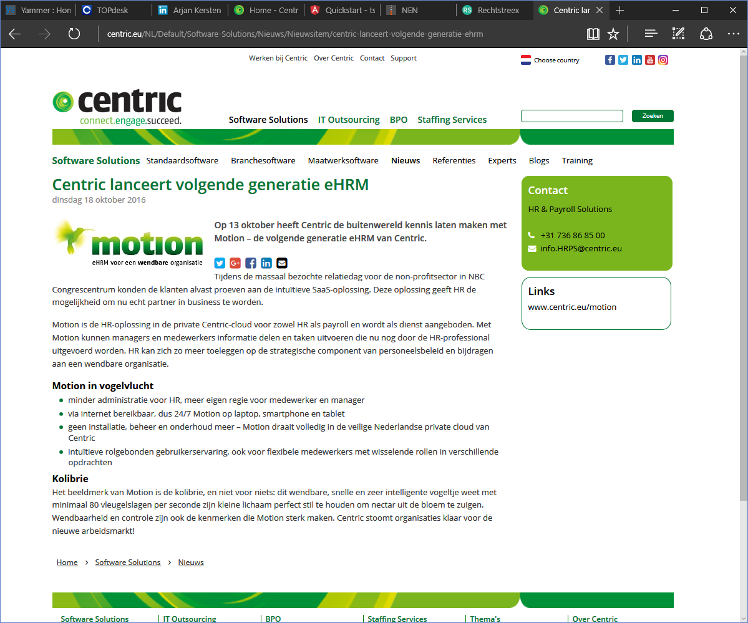

Slide 32
2nd example tax software transition to SAAS

Slide 33
Key2Belastingen in figures
Object | # | DB | Inputs | Outputs | Selections
Forms | 1.578 |  | 1.578 |  | 1.578
Batches | 465 |  | 465 | 465
Workflows | 141 |  |  | 141
Letters | 71 |  |  |  | 71
Scripts | 232 |  |  | 232
Reports | 489 |  |  |  | 489
Database procedures | 5.929
Managestabels (*1) | 2.401 | 2.401
Total | 11.306 | 2.401 | 2.043 | 838 | 2.138
Points per function |  | 7 | 4 | 5 | 4
Total no FP |  | 16.807 | 8.172 | 4.190 | 8.552
Total |  |  |  |  | 37.721
Estimation 37.721 FP
332 men year
Value 37 Miljoen
30 developers

Slide 34
Challenge is big
Competitiveness declining
Complexity increasing
Technology is old
But still functional very fit, best in class to be honest
How to convince the board about an approach?

Slide 35
Business case logic for a boss
This will always work
Lower cost, higher turnover
But how??
Another trick
We will completely rebuild to new modern application
But what is the cost? How long will it take?
Remember: >300 men year
So we need to play the technology card
We do some magic
Which will lower cost and increase turnover
How??

Slide 36
Business case logic
Higher productivity
Smaller applications
Lower cost
Less management
Less software
Less bugs
Customer retention
Webbased UI
Modern applications
Increasing turnover
New business
3 tier model (REST API)
SaaS ready

Slide 37
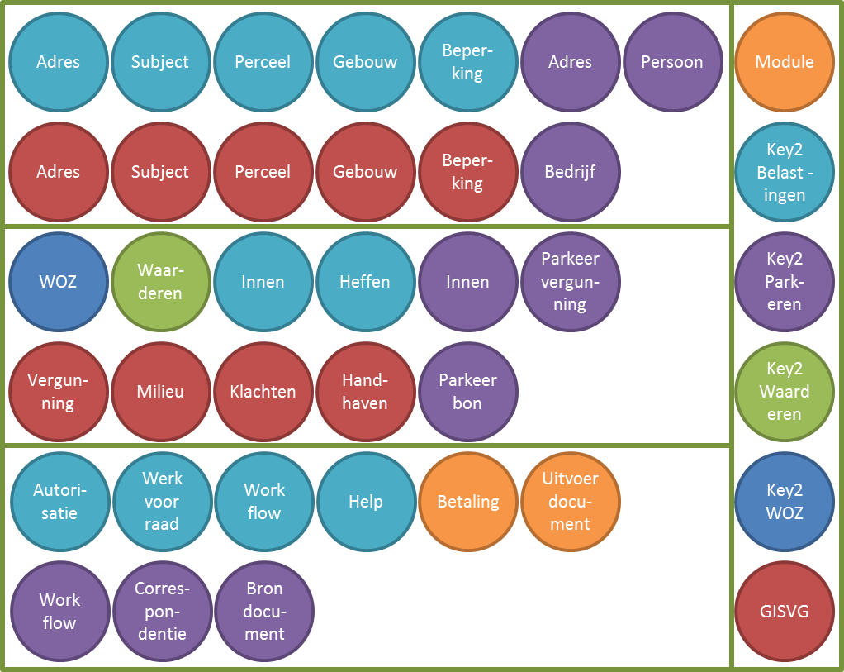
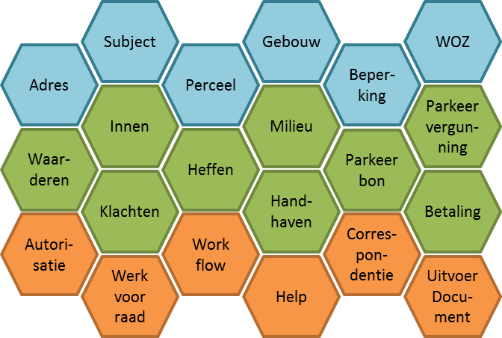
reduction
Removing duplication from 33 modules to 21 components is 37% decrease of software volume

Slide 38
Minimize impact
LV
K2DDS
Data Ma-kelaar
Major change
Subject
Adres
Minor change
No change
K2B
Baker ware
GISVG
K2 Park-eren
Cipal

Slide 39
Cost reduction
Cost reduction
 | 2016 | 2017 | 2018 | 2019 | 2020 | 2021 | 2022 | 2023 | 2024 | 2025 | 2026
Maintenance % | - | - | 4% | 8% | 12% | 16% | 19% | 23% | 27% | 31% | 35%
Maintenance K€ |  |  | 100 | 300 | 400 | 500 | 700 | 700 | 900 | 1000 | 1000
Cumulative
 | 2016 | 2017 | 2018 | 2019 | 2020 | 2021 | 2022 | 2023 | 2024 | 2025 | 2026
Spending | 200 | 800 | 900 | 400 | 400
Reduction OH |  |  | 100 | 300 | 400 | 500 | 700 | 700 | 900 | 1000 | 1000
Total cash flow | -200 | -800 | -800 | -100 | 0 | 500 | 700 | 700 | 900 | 1000 | 1000
Cumulative | -200 | -1000 | -1600 | -900 | -100 | 500 | 1200 | 1400 | 2300 | 3300 | 4300
Netto Present Value 1.329
Cost reduction up to 35% in 2026
Break-even point 2021
Note: not real figures, but same order

Slide 40
Making money with the cloud workshop assignment

Slide 41
Making money with the cloud
Benefits of cloud for start-ups and entrepreneurs
No staff needed
No office space needed
Online visibility by social media and communication services
Global availability if multi-language and multi-culture
Access to enterprise level software for small prices
Other benefits?
Notes:
There are many benefits for cloud startups and entrepeneurs. Normal companies hire staff for their activities, but you better hire services on a pay-per-use basis. Then you are as flexible as possible. Same counts for office space. Why rent a building if you can do your work in a hotel or your living room? There are many places where you can work on a pay-as-you-go basis.
You need to present yourself to your potential customers. So visibility is key, especially online. Another thing is reputation management and social media care.
It is easy to scale up but be aware of manual activities needed like processing of purchases, handling of goods and so on. For those you may need normal services and those services are often expensive especially when doing business internationally.
Last thing is that you can use enterprise level software by using cloud.
Do you see any other benefits?

Slide 42
Goal of this assignment
To identify and develop Cloud services that can help startups.
Not just by looking at their pros and cons, but also by taking into account the financial consequences.
In short: define a new business based on Cloud services and prove that your startup will be profitable in a reasonable time frame.
Date | Topic | Description
April 4-22 | Homework | Assignment and preparation for assessment
May 8th | First groups present
May 9th | Last groups present

Slide 43
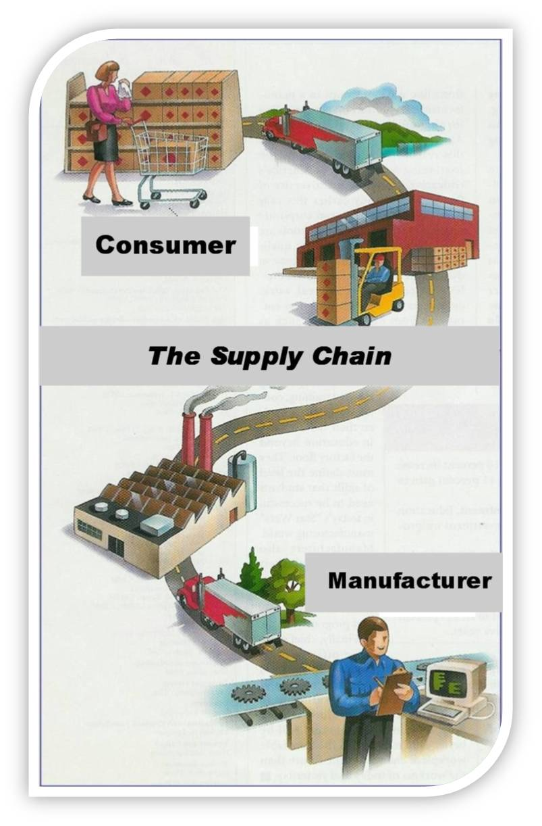
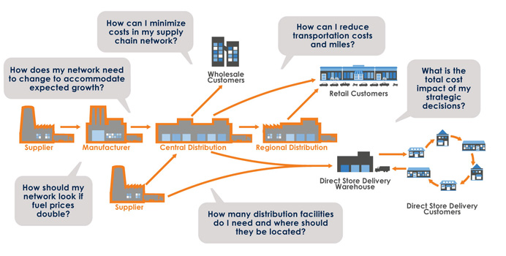
Making money in the supply chain
Notes:
Well, let’s see if we can find a type of business that needs to be disrupted. Look at the picture on the left side. It looks very simple: the supply chain between supplier and consumer.
But, the whole chain is very complex, and many parties are involved, and worse: want to be involved and make a profit of their activities. Guess who has to pay for that? You and me.
Why is it so complex? It has its benefits of course, and if they do their job well, the lower the prices of goods will be. But many parties don’t think about the end price. They only see what they have to pay and what money they can make by adding value. Alright, they add value, but for who? Is repackaging adding value? Is package design so that we find goods attractive really added value?
I think we could try to cut out some of these parties.

Slide 44
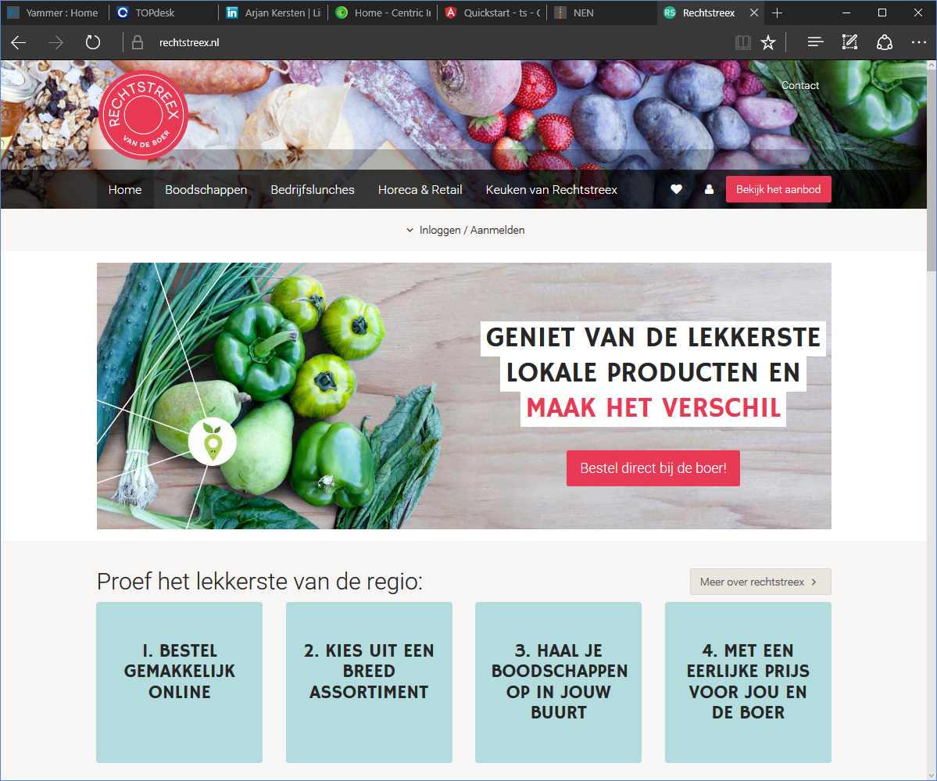

Slide 45
Start a virtual company
Choose your new role in the world of direct trading.
May be an online trading platform or a kind of Uber for transporting the goods between supplier and customers. Be innovative and creative!
Design and develop your core service.
This company is completely virtual, that means you do everything from the Cloud, using a variety of cloud services. But, do not underestimate it! You need to select Cloud services for the following:
Financial process, Customer contact, Contracting, Marketing
For each topic you need to find at least 2 providers and it is your task identify the best service for your business.
Be aware that due to the nature of direct trading, you have to deal at least with 10.000 customers a year.
As your company is completely virtual, your core service has to be a cloud service too.
You have to enter the investment cost for that service and yearly exploitation cost in your business case. And remember, these need to be realistic.
Good news: Virtual Cloud Ventures is willing to lend you between RON 10.000 and RON 50.000
With 10% interest if you solve it in one year, otherwise it is 25%.
Your company is successful in terms of turnover: first year RON 30.000 and increases by 1.4 yearly.
But, tell how you think you will make this amount of money.
Cost of living is RON 3.600 per month and we assume your company is tax free the first 5 years.

Slide 46
Expected results
Selection of cloud services (min. 2 per topic), matched with your company needs and yearly cost for your company
There are many directories for SaaS products, including this one: http://www.cloudshowplace.com/application/
Define and describe your core service and determine investment and exploitation cost of your own service
What is the USP of your service?
Convince us we won’t find an existing service for that!
Tell how turnover will be achieved
Define the business case for your company and calculate the break even point
Format: Business Model Canvas and Excel-sheet
http://www.alexandercowan.com/business-model-canvas-templates/

Slide 47
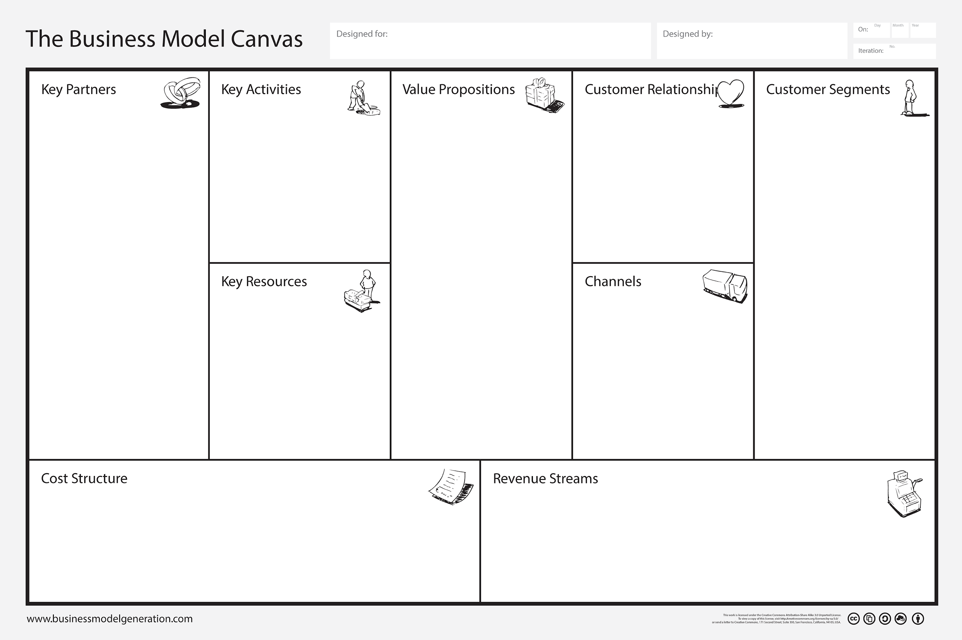
Canvas business model

Slide 48
Business case

Slide 49
Thank you! Any questions?
Leen Blom
+31-653562767
leen.blom@centric.eu

